Slide 1


Movie Recommendation System
Team #19
蘇彥 楊孟翰 林思宇 高偉傑

Slide 2
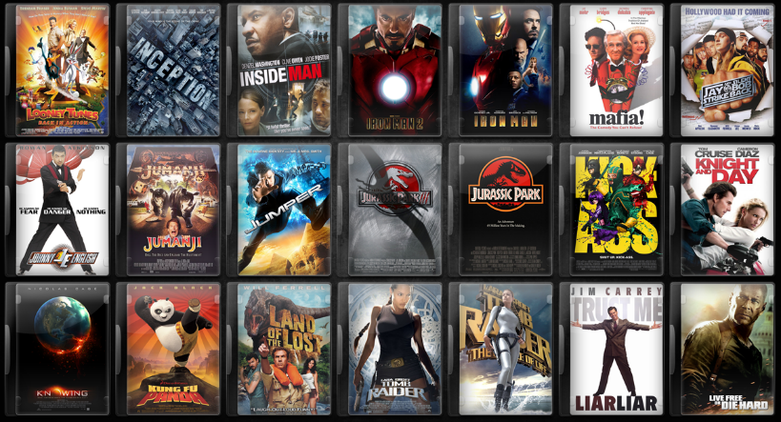
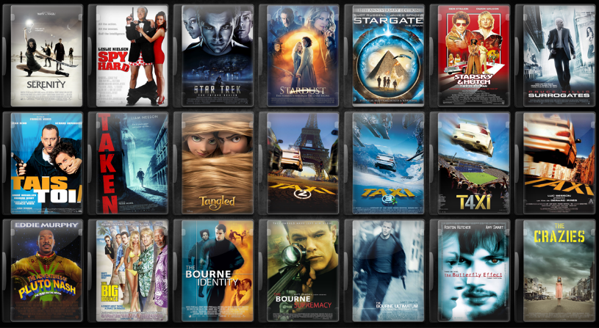
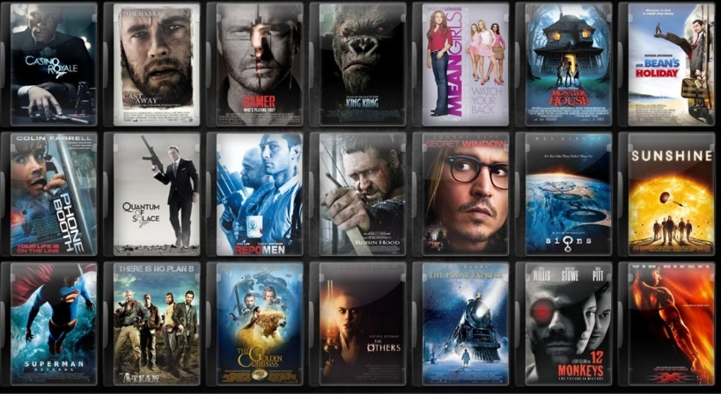
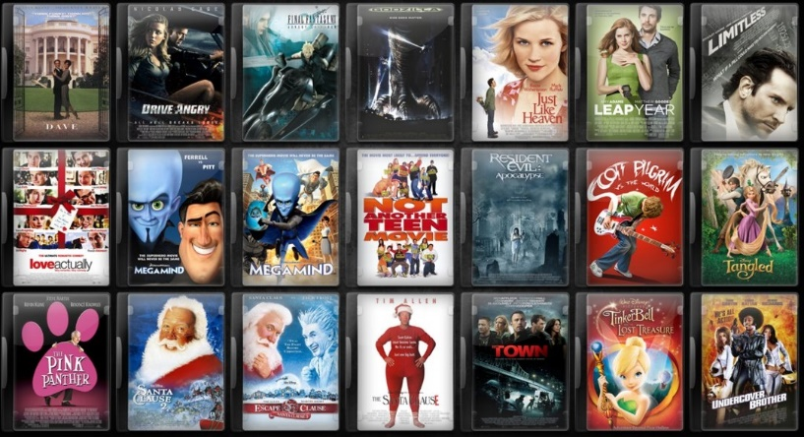
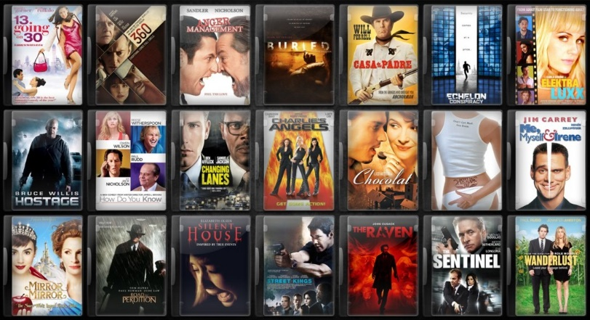
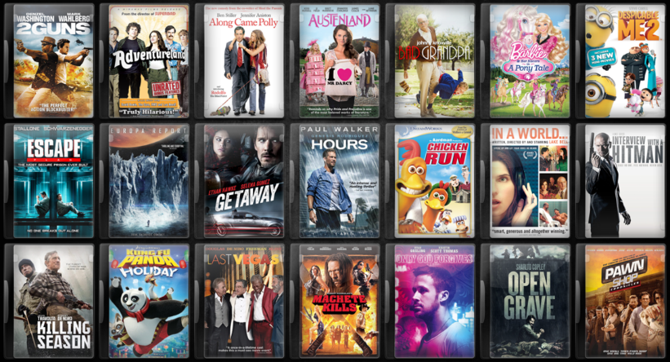

How does System work

Slide 3
How does System work
MovieLens Data (Last updated 4/2015)
100,000 Ratings , 8,570 Movies , 706 Users
Collaborative Filtering Algorithm
Show the predict accuracy (MAE)
User information
Computing the Similarity
Recommend TOP 5 Movies
Prediction Value

Slide 4
How does System work
User Interface
Sign up / in
Rate Movies that you have watched
Compute and Predict
Show the Movies you may like
Change the recommendation as user gives more information

Slide 5

What’s the challenge

Slide 6
What’s the challenge
Prediction accuracy
Computing Time
It is difficult to “Cold start”

Slide 7








How to overcome the challenge

Slide 8

How to overcome the challenge
Improve our algorithm
Thinking How to add new user data sooner

